Slide 1

Expense Management
project submitted to
Sir Laeeq Khan
By: Muaaz Shoaib-2021-CS-188

Slide 2
Project Description
Expense Management System is a web application used to manage your finances. The system offers a seamless interface for tracking , categorizing, and analyzing expenses ensuring users to maintain a clear and organized profile.

Slide 3
Project Features
Sign-up & Sign In
Budget Management
Expense Calculation
Recommendations
Reminders Management

Slide 4

Technology Stack

Slide 5


Backend

Slide 6
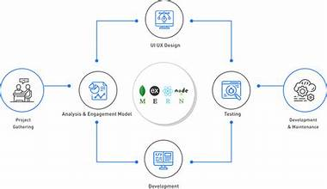
Flow Diagram

Slide 7
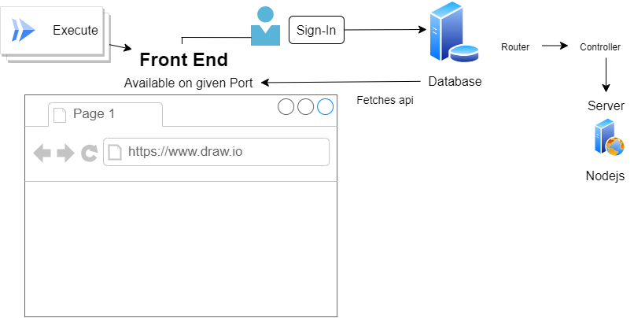
Flow Diagram

Slide 8
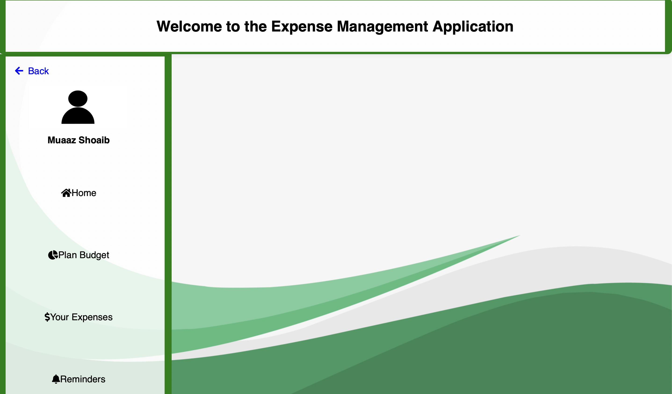
Wireframes
Home Page

Slide 9
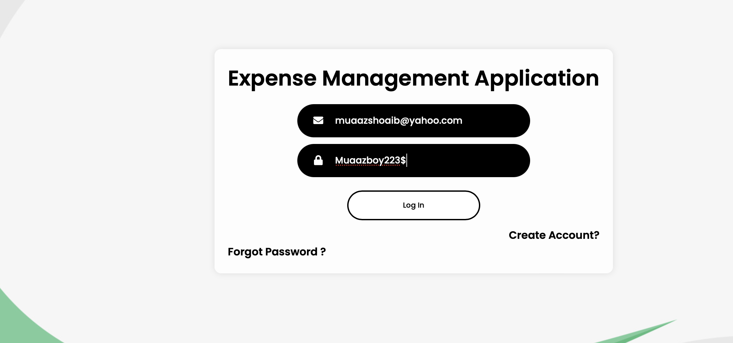
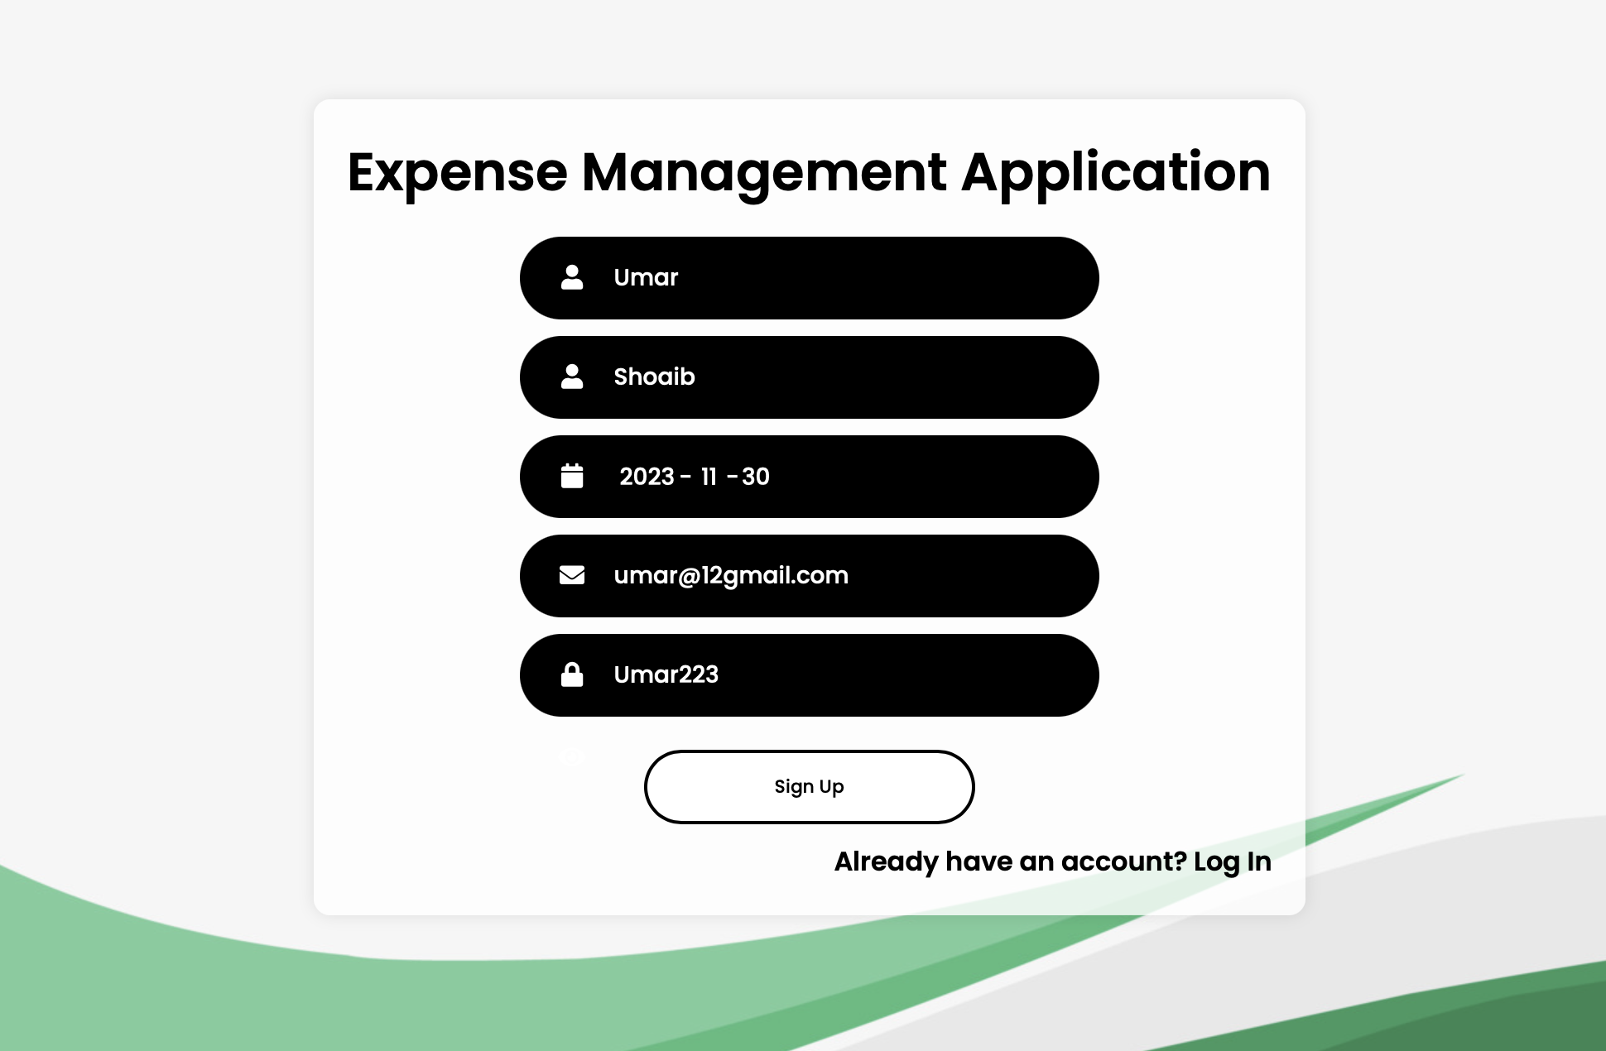
Wireframes
Sign-In & Sign-Up

Slide 10
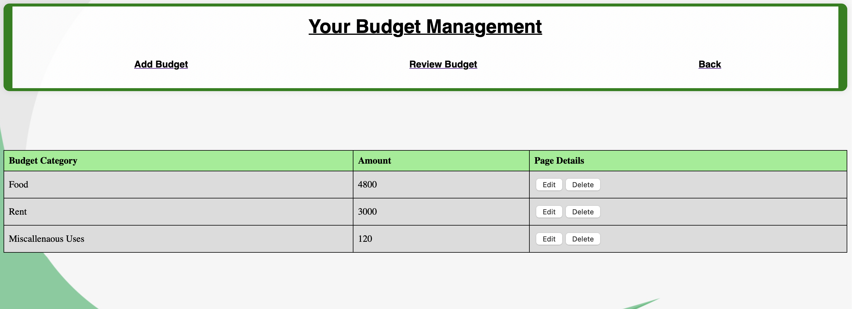
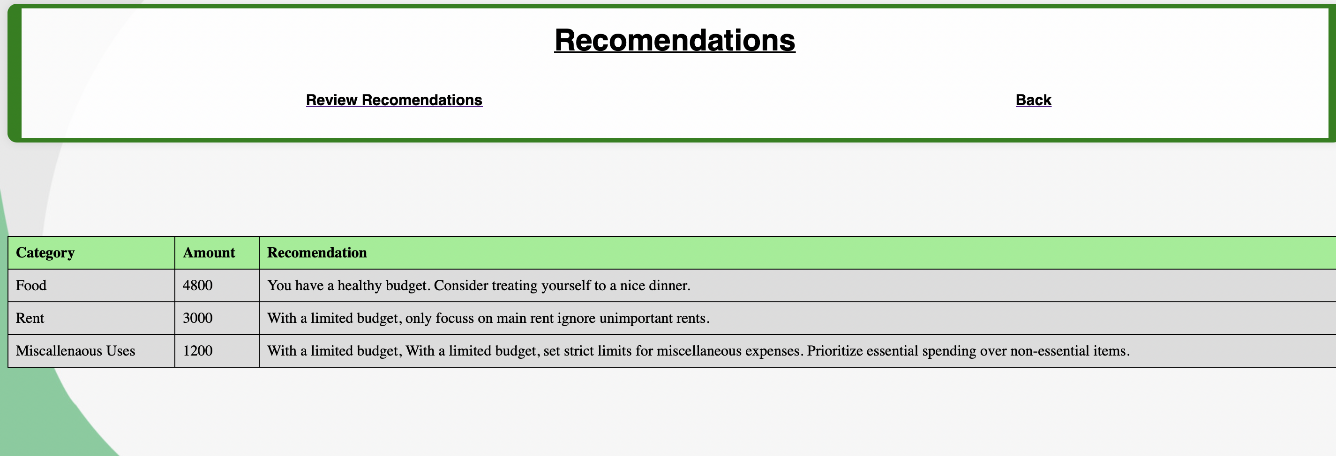
Wireframes
Budget & Recommendations

Slide 11
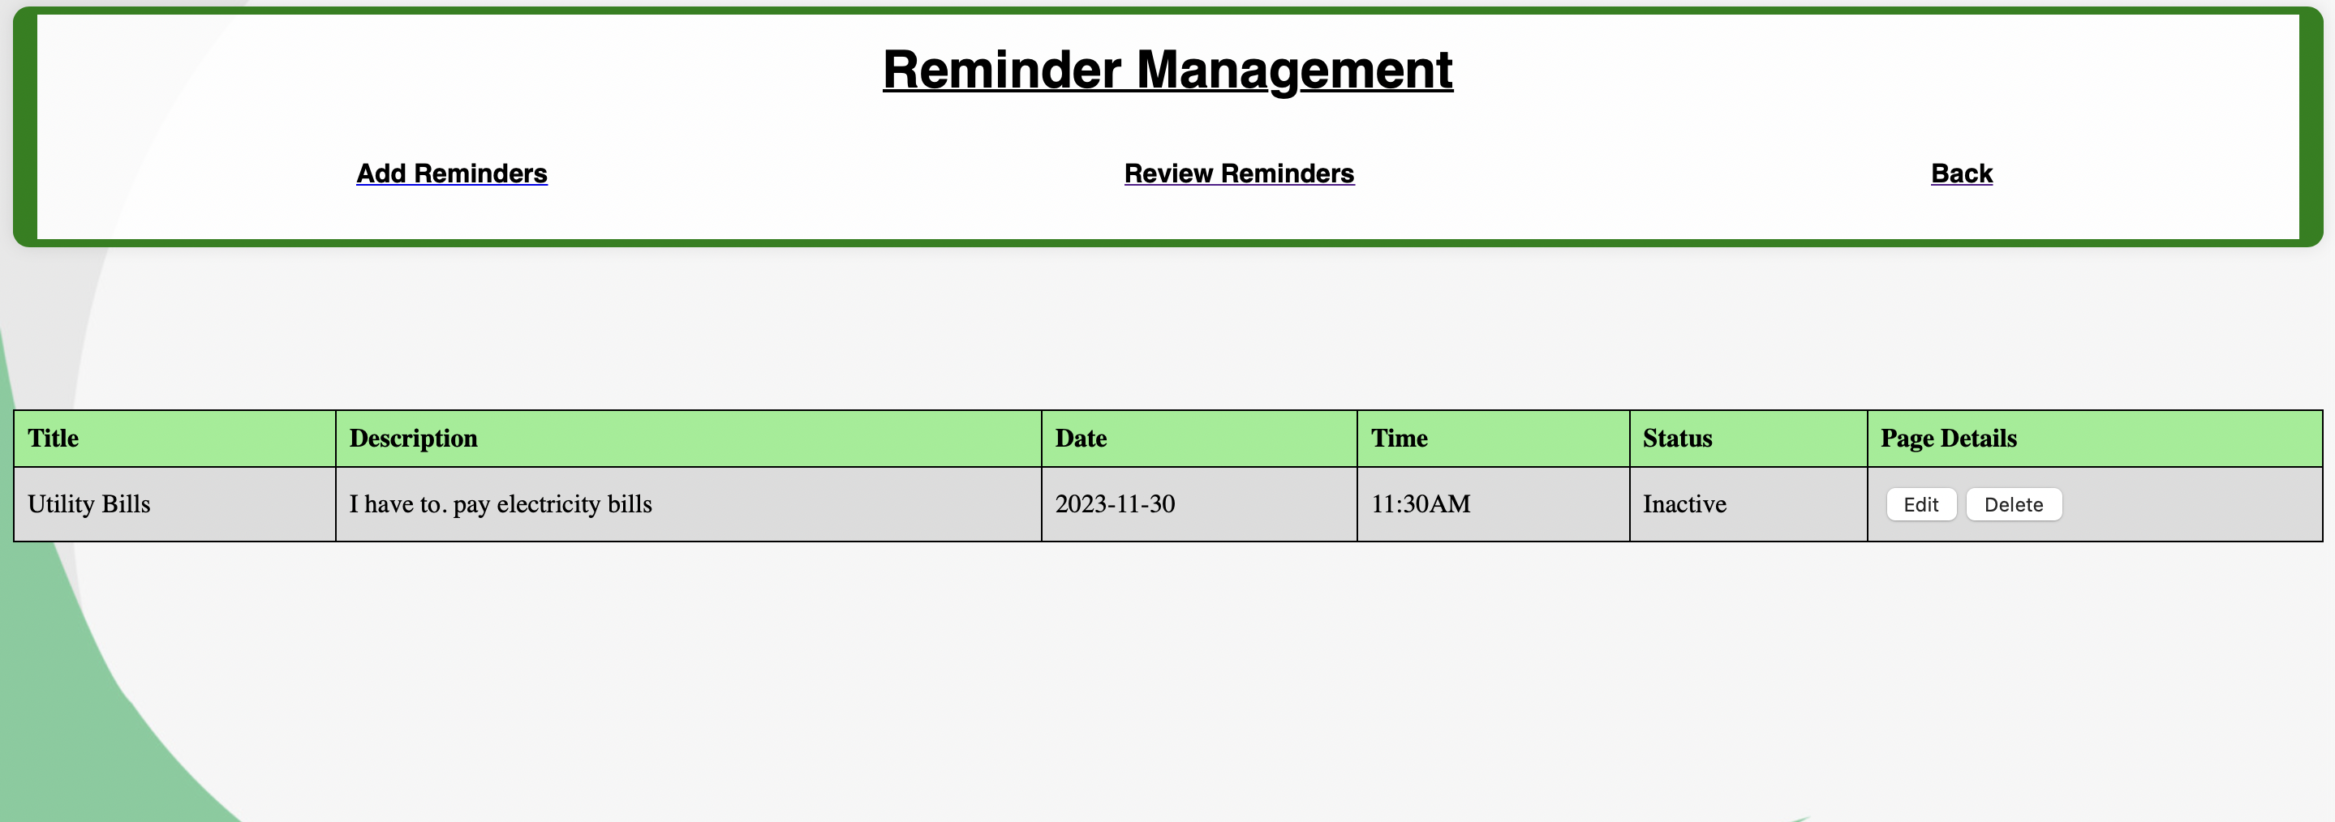
Wireframes
Reminder

Slide 12
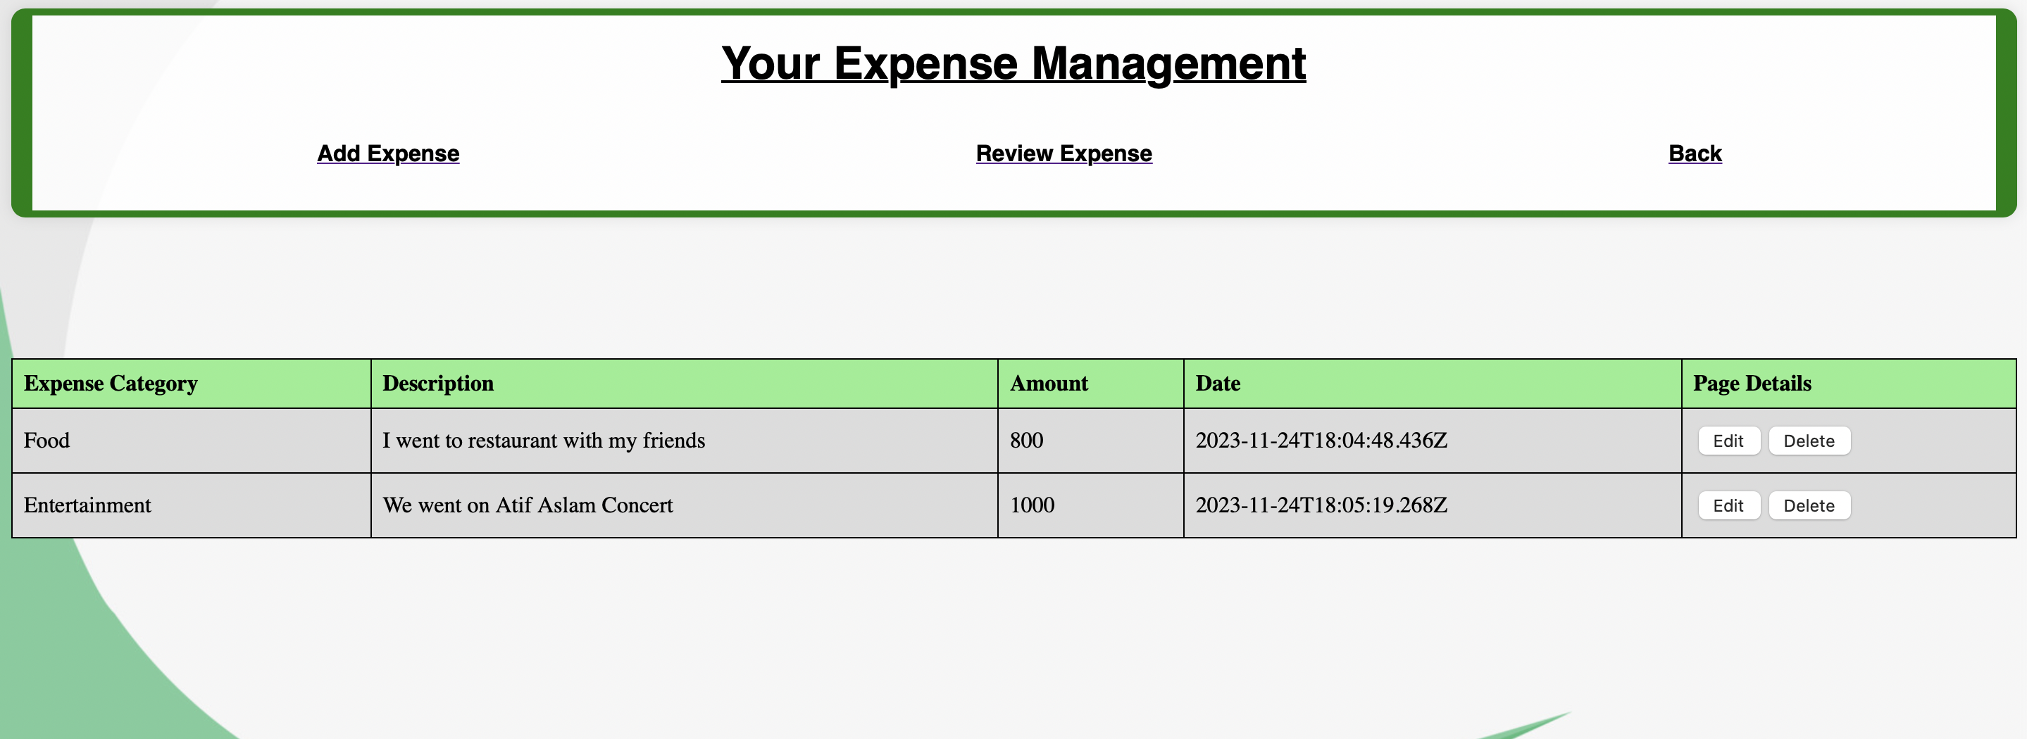
Wireframes
Expense

Slide 13
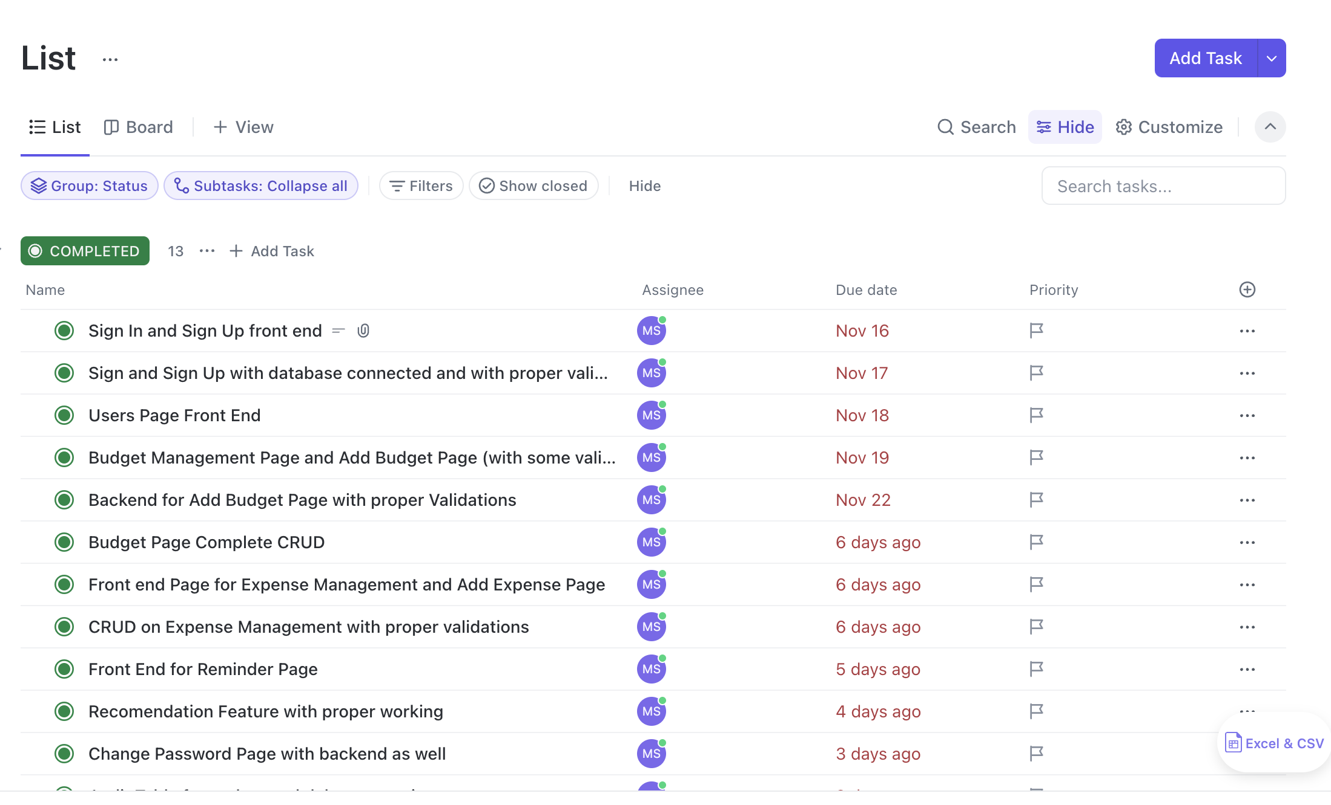
Click Up
Task management tool

Slide 14
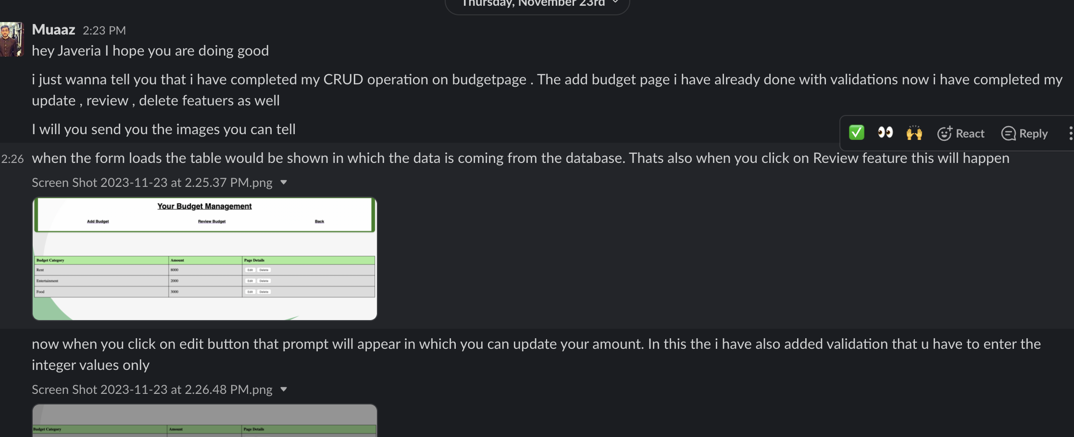
Slack

Slide 15
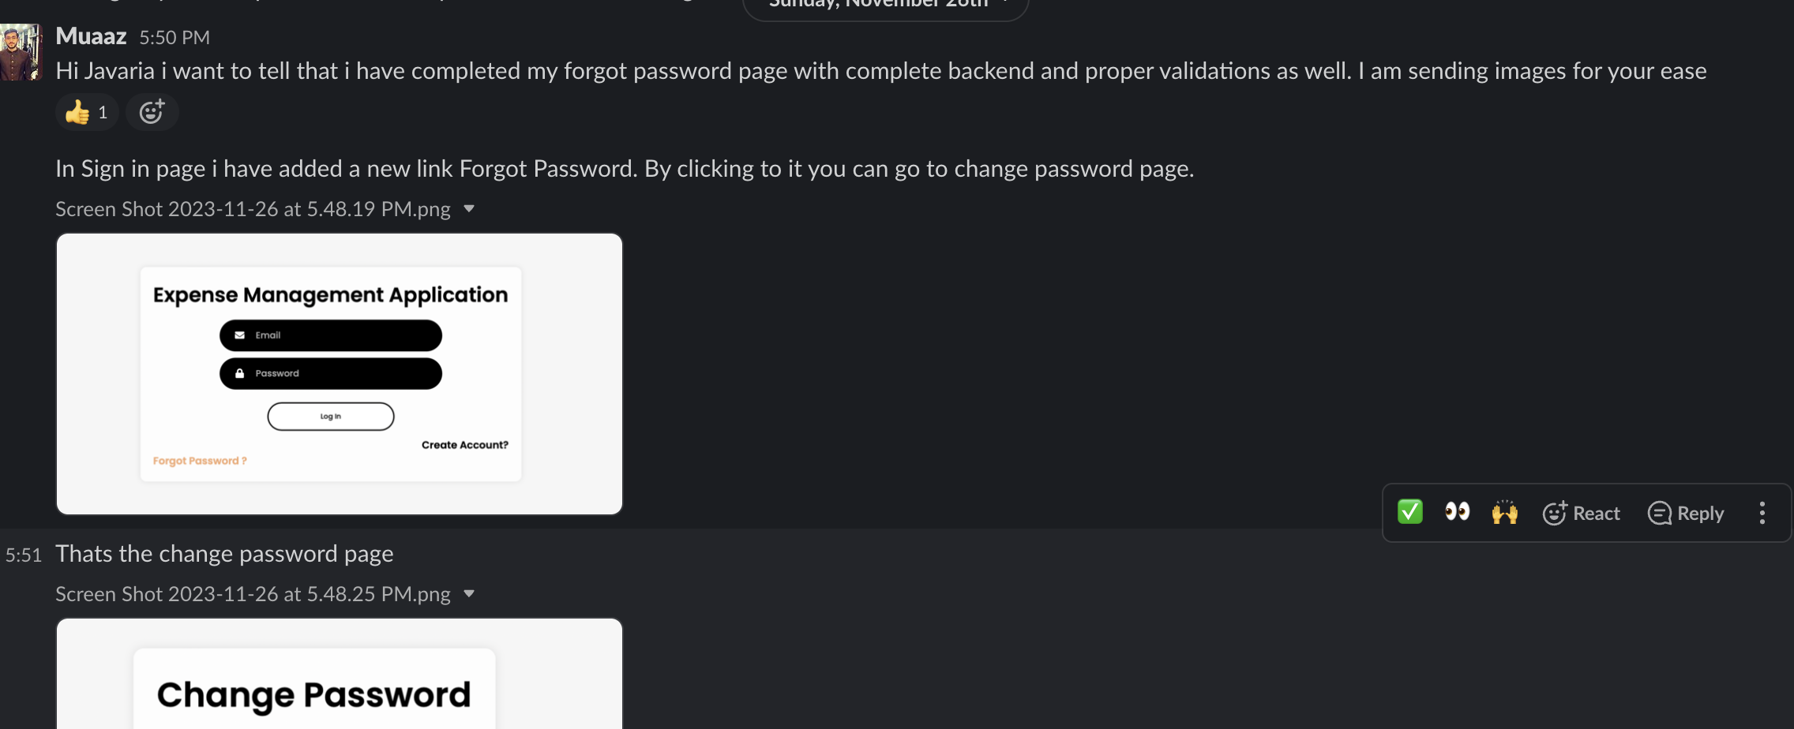
Slack

Slide 16
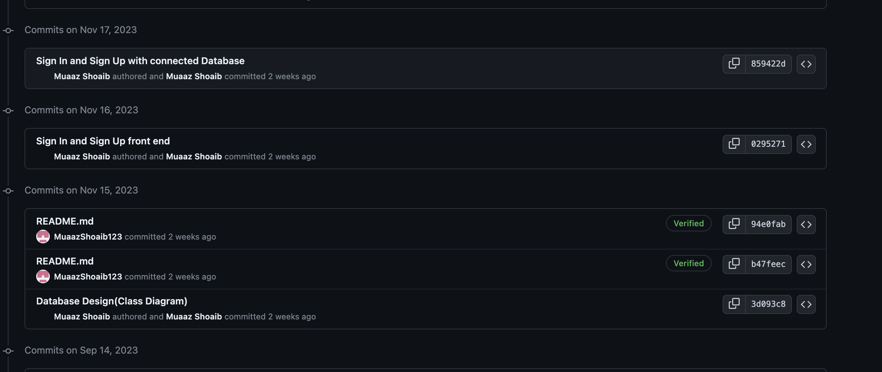
GitHub

Slide 17
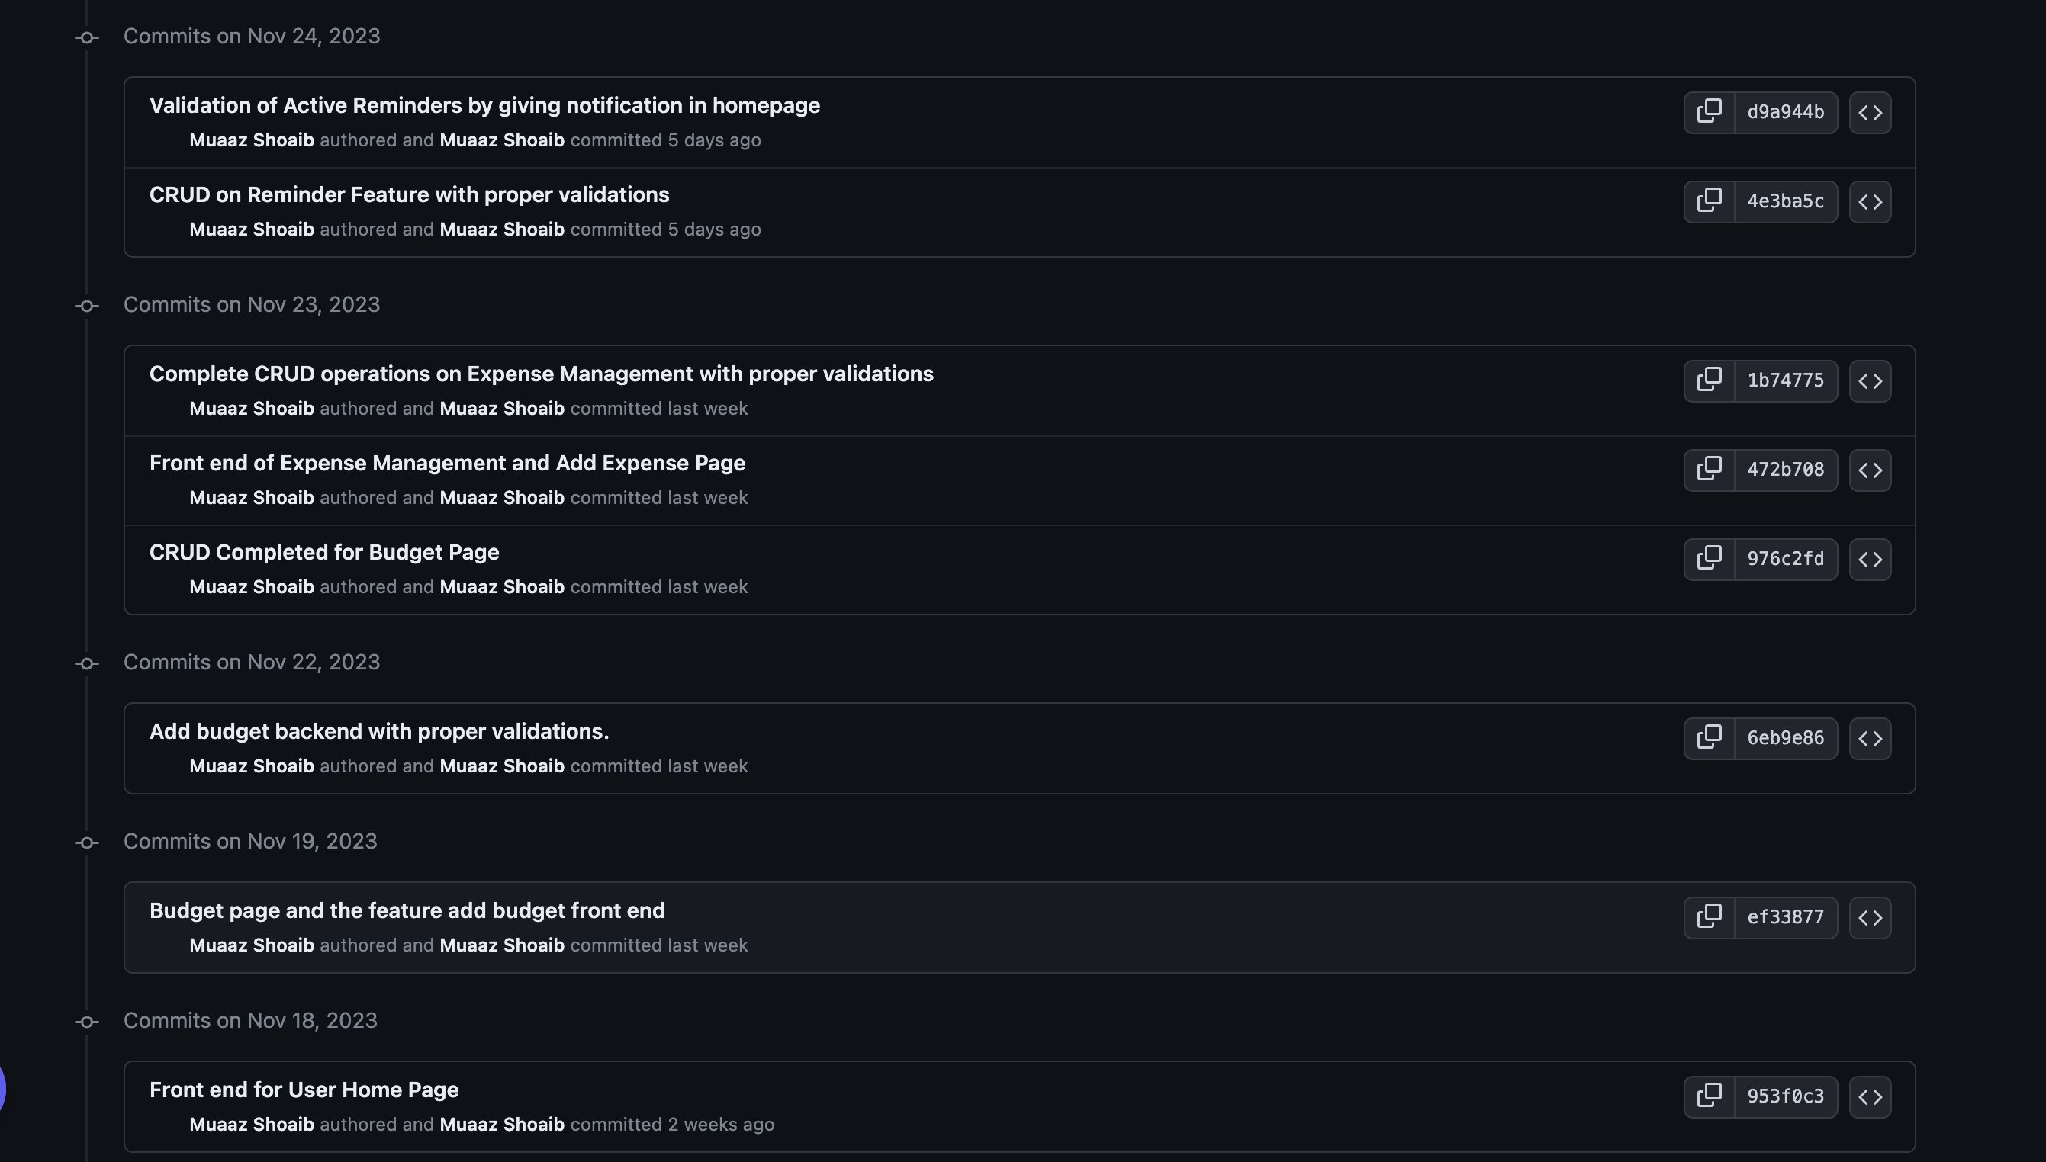
GitHub

Slide 18
Learning Outcomes
MongoDb
Node js
Mern stack technology
Command on HTML & Bootstrap
Professional Use of
Task Management Tools
GitHub
Slack

Slide 19
Learning Outcomes
Professional Soft Skills
Time Management
Communication Skills
Documentation

Slide 20
Thank You
MuaazShoaib@yahoo.com

